Slide 1
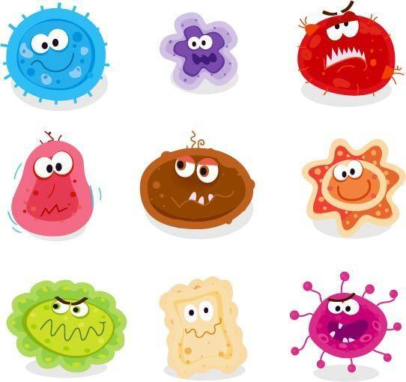
Impacts from the Covid-19 Pandemic Across the United States (2020)
Alex Cheung, Carol Chu

Slide 2
Data Source
We collected information from the Covid Impact Survey and the Covid Tracking Survey from NORC at the University of Chicago
The Impact Survey was ran in the first and second quarters of 2020 from April 30 - May 3, May 4 -10, and June 1 - 8.
This survey aimed to fill an information gap in the United States about the initial impact of Covid-19 on Americans and their responses to the pandemic through a 3 week survey spread several months.
The Tracking Survey ran from May 21 - 29, June 22 - July 6, July 22 - August 10 2020.
This survey was conducted as a nationally representative longitudinal study to understand Americans' beliefs, mental health, and outlook before, during and after the coronavirus outbreak.
The difference between the two surveys are that the impact survey is conducted in the first half of 2020, while the tracking survey was conducted in the second half.
Their aims were different in that the first survey just wanted Americans’ opinions on the initial impact of the pandemic while the second survey wanted to conduct a study comparing current beliefs to Americans’ responses to prior national tragedies.

Slide 3

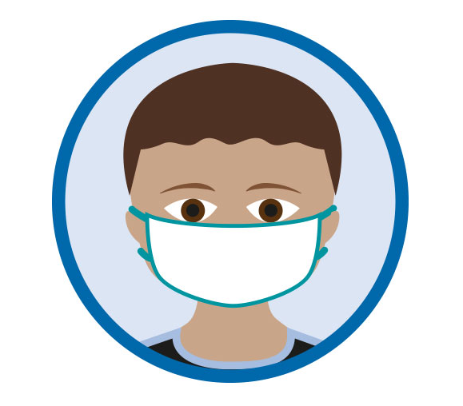
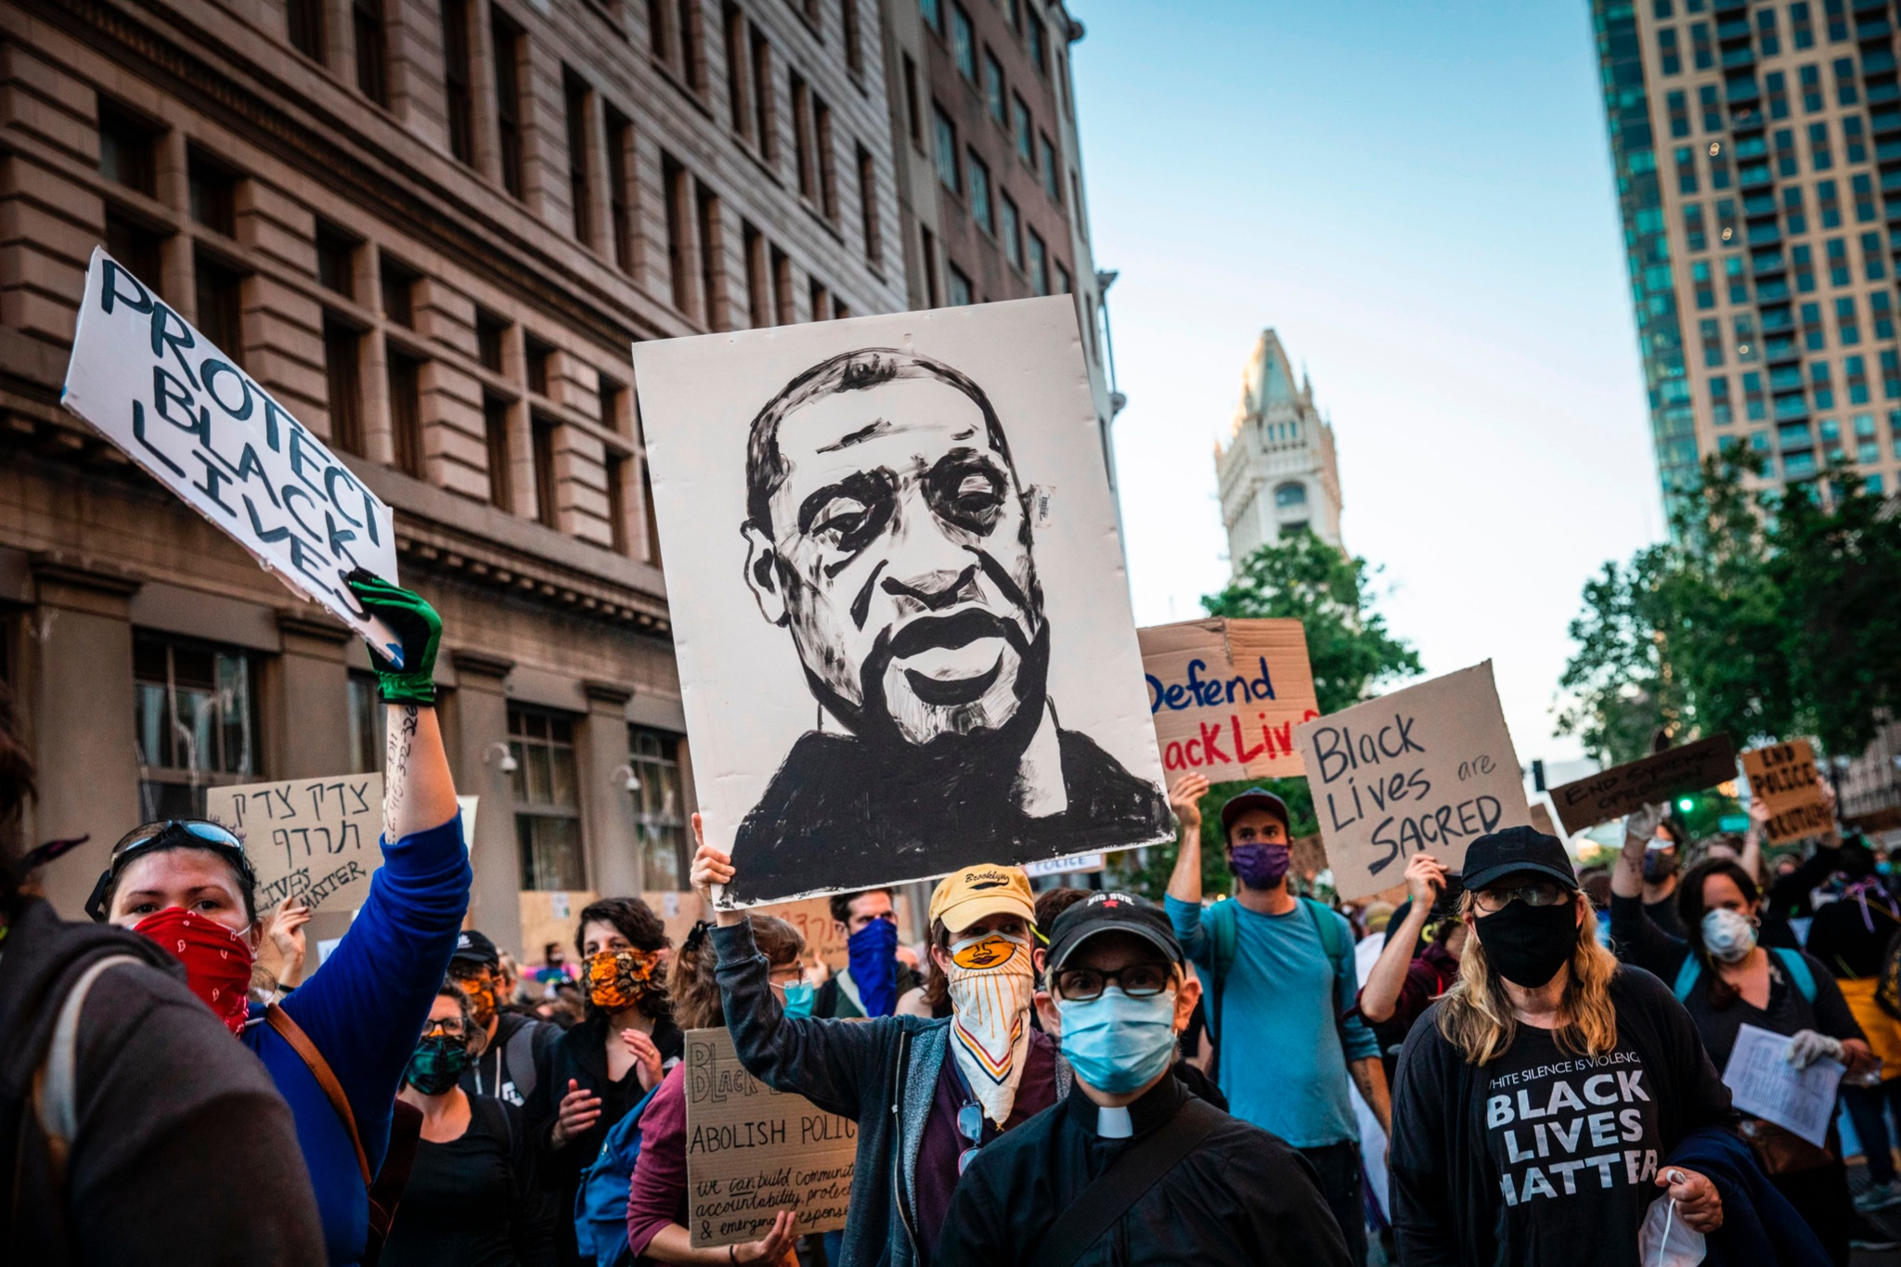
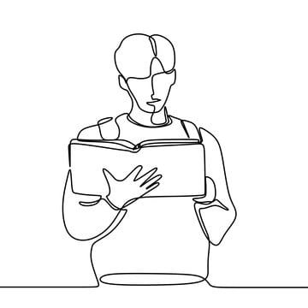
Background — In Tracking Surveys
People exposed more to the coronavirus either personally or geographically in a highly-impacted area is linked with greater feelings of loneliness and other negative emotional states.
Black, Hispanic, and younger Americans have been particularly likely to face such economic hardships.
The responses to Floyd’s killing and the economic hardships related to the pandemic are having independent effects on health and well-being.
Younger adults, women, those with lower income or lower educational attainment, and those who often watch, read, or talk about the coronavirus report higher rates of various symptoms, compared to other groups.
Notes:
1.是因為隔離嗎？ 因為曝光越大就越容易中獎
2.在傳播理論中，低學歷者和高學歷者他們得知和傳播訊息的方式並不一樣
針對學歷少的我們公開少，他們就只知道自己眼前得世界
針對學歷多的我們公開多，讓他們根據自己知道的知識判斷
難道面對疫情不一樣嗎

Slide 4
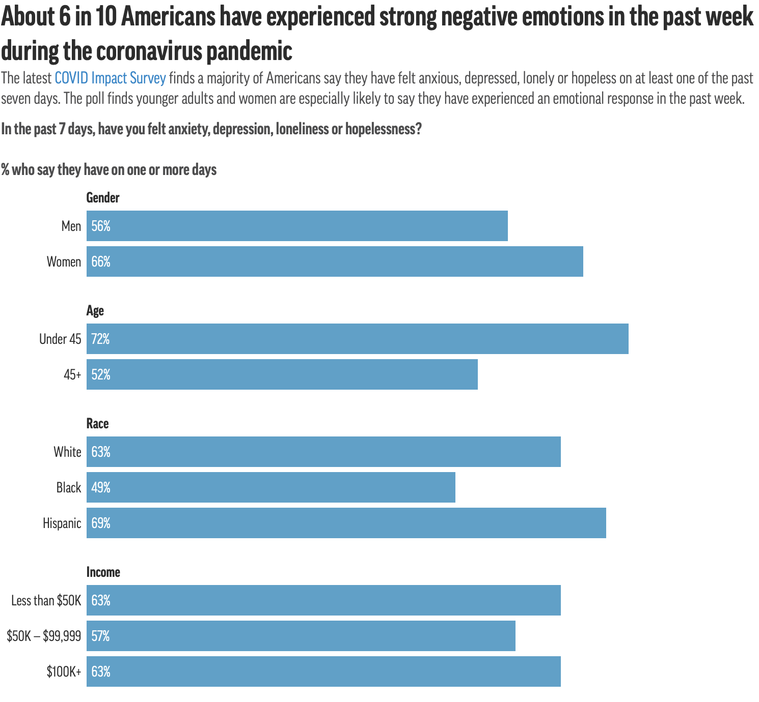
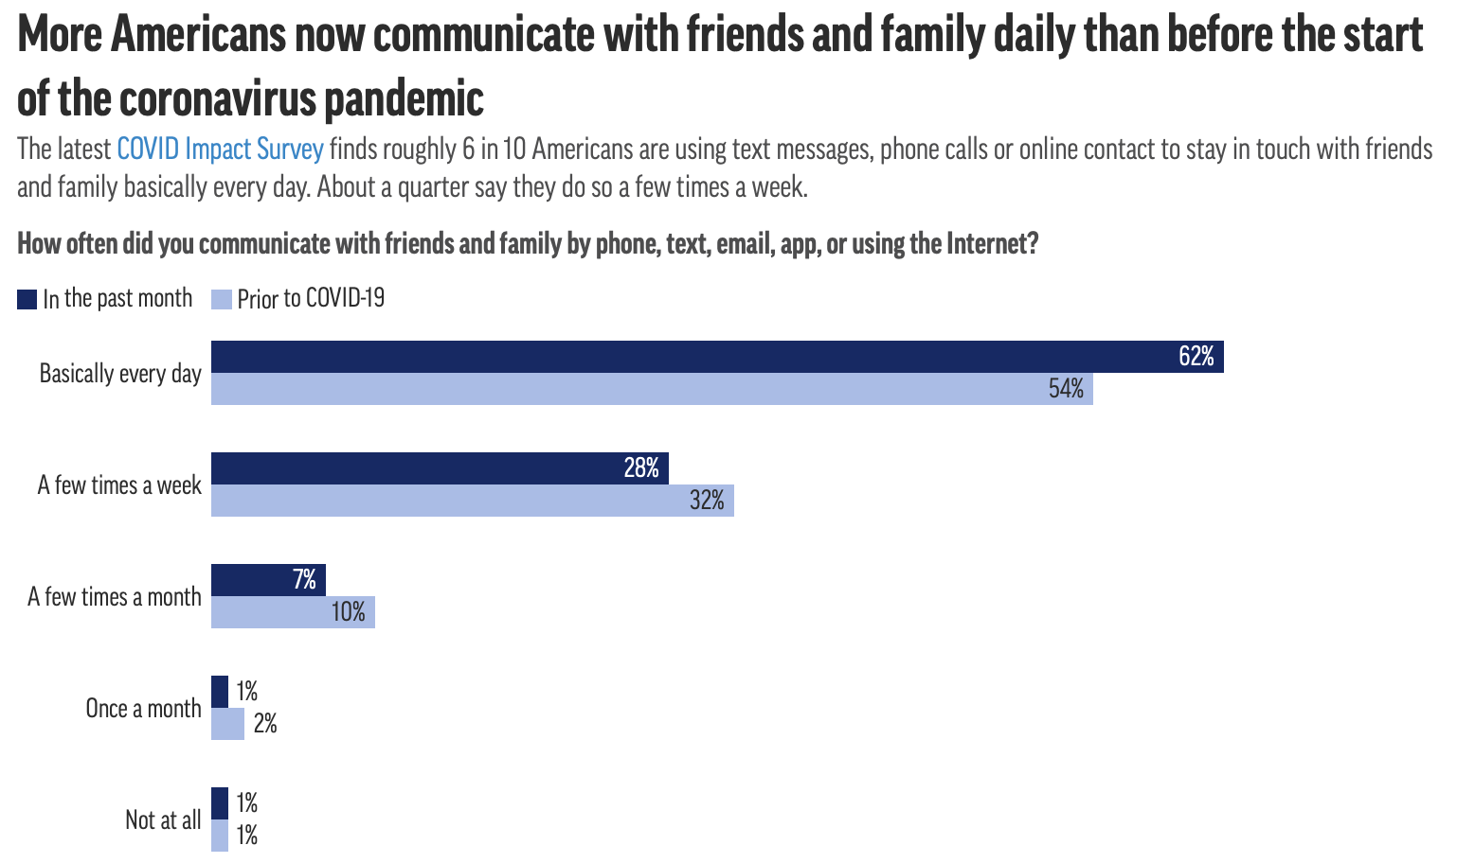
Background — In Impact Surveys

Slide 5
Research Questions
Investigating the impact of the first year of Covid-19 on job employment.
How does mask-wearing differ among certain demographics and regions across the U.S?
Looking at the differences of depression time length among Americans in different regions.

Slide 6
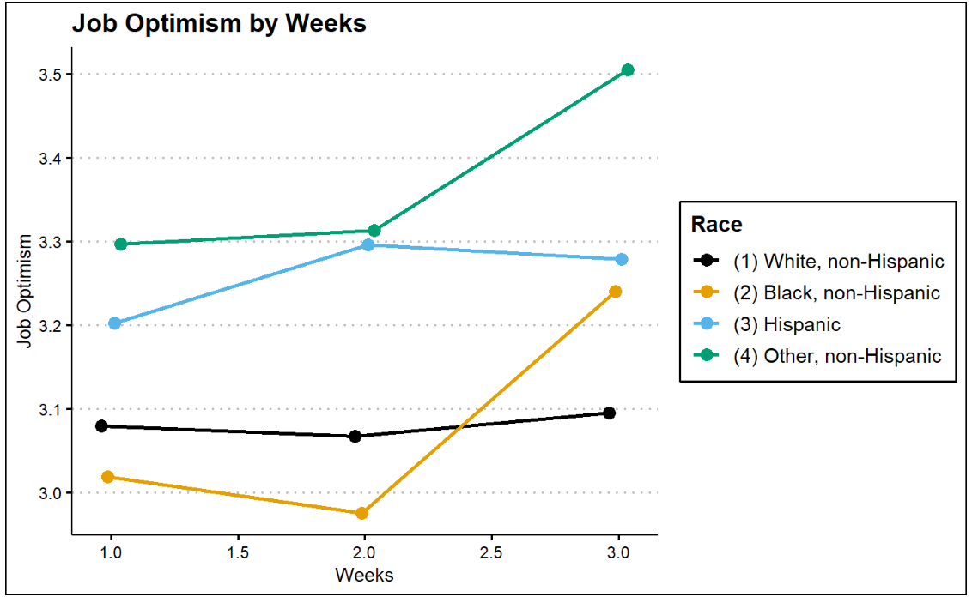
Likeliness of Job Employment in 3 Weeks Time By Racial Background

Slide 7
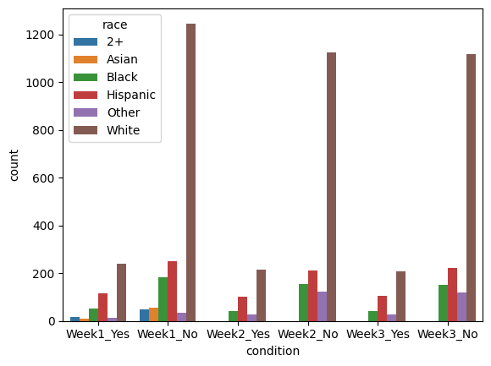
Likeliness of Job Employment in 3 Weeks Time By Racial Background

Slide 8
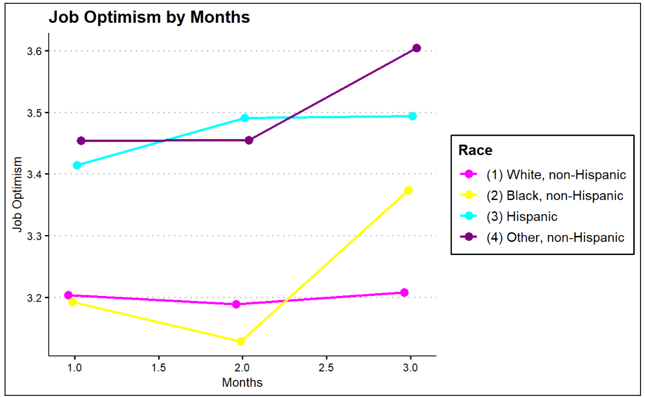
Likeliness of Job Employment in 3 Months Time By Racial Background

Slide 9
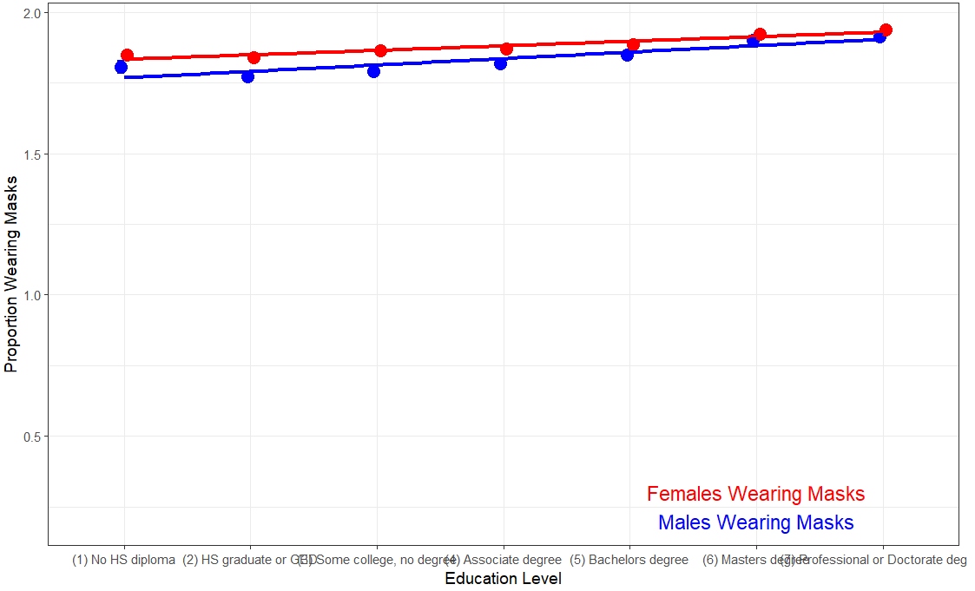
Mask Wearing Usage Increases with Education Level

Slide 10
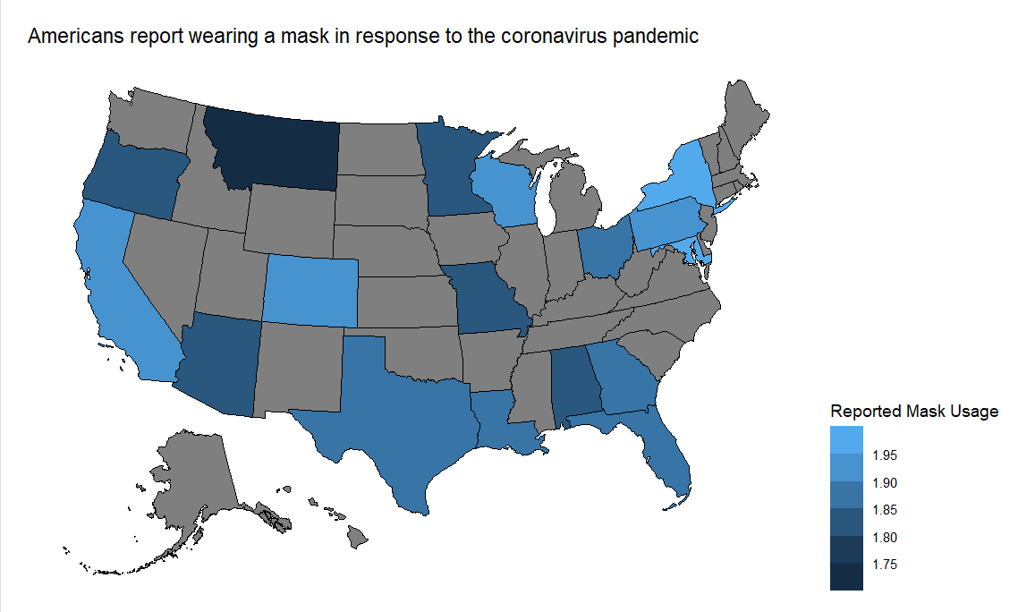
Most Americans say they are wearing a mask
to slow spread of coronavirus

Slide 11
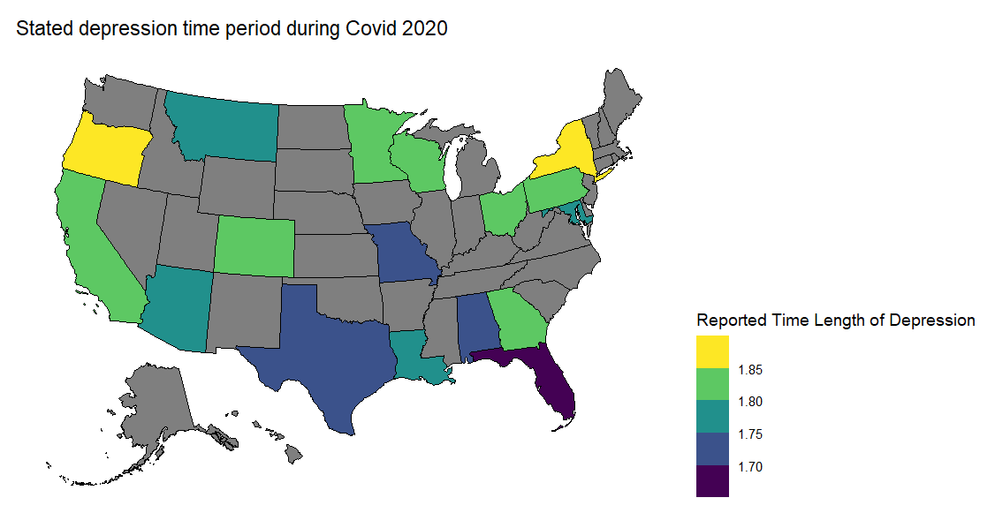
Americans’ Average Depression Period During the Pandemic

Slide 12
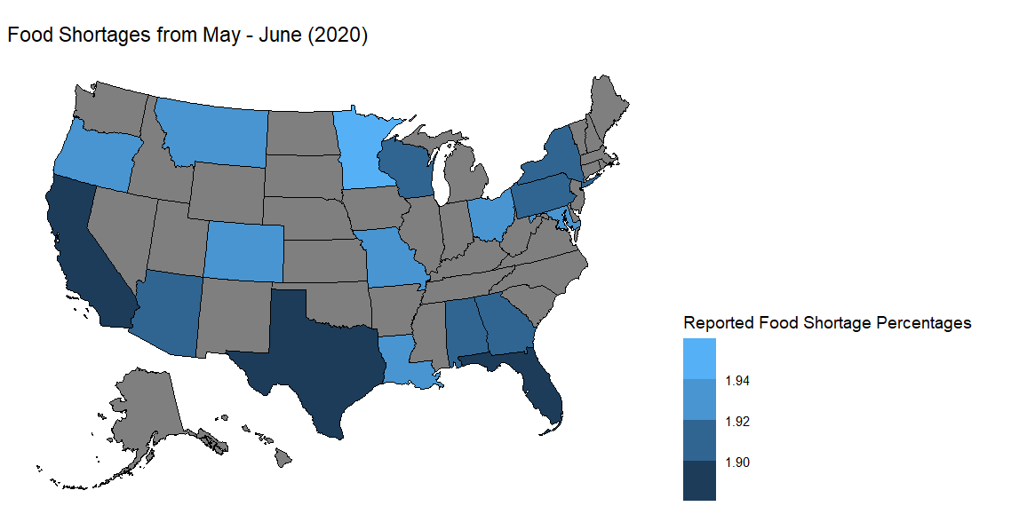
Percentage of Food Shortages Among Americans

Slide 13
Next Steps?
Inform Future Research
  Why did we see certain trends occur in different racial backgrounds, gender, and regions?
  Explore in bigger scale --
compare depression response region with the diagnosed population, and compare with other data about quarantine population.
Compare household income & mental score (see their correlation (Maybe we are happier when poorer?) 🤔
Inform Policy
  We can use this information to get more access to mental health care to Americans who are suffering from the impact of the pandemic
  Advise policy on how to tackle the pandemic through more government assistance, determining how to implement future mask mandates, and other actions to combat the virus.
Any Questions or Comments?
Notes:
In

Slide 14
Reference
NORC at the University of Chicago
https://www.norc.org/Research/Projects/Pages/covid-response-tracking-study.aspx
Covid Impact Survey
https://www.covid-impact.org

